Slide 1

Digital Image Processing
Dr. Mubashir Ahmad (Ph.D.)

Slide 2
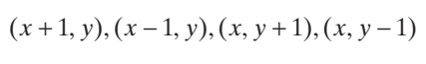
SOME BASIC RELATIONSHIPS BETWEEN PIXELS
A pixel p at coordinates (x, y ) has two horizontal and two vertical neighbors with coordinates.
This set of pixels, called the 4-neighbors of p, is denoted N 4(p ). The four diagonal neighbors of p have coordinates
and are denoted N D(p). These neighbors, together with the 4-neighbors, are called the 8-neighbors of p, denoted by N 8(p). The set of image locations of the neighbors of a point p is called the neighborhood of p. The neighborhood is said to be closed if it contains p. Otherwise, the neighborhood is said to be open.

Slide 3
ADJACENCY, CONNECTIVITY, REGIONS, AND BOUNDARIES
Let V be the set of intensity values used to define adjacency. In a binary image, V = {1 } if we are referring to adjacency of pixels with value 1. In a grayscale image, the idea is the same, but set V typically contains more elements. For example, if we are dealing with the adjacency of pixels whose values are in the range 0 to 255, set V could be any subset of these 256 values. We consider three types of adjacency:
1. 4-adjacency. Two pixels p and q with values from V are 4-adjacent if q is in the set N 4(p ). 2. 8-adjacency. Two pixels p and q with values from V are 8-adjacent if q is in the set N 8(p). 3. m-adjacency (also called mixed adjacency). Two pixels p and q with values from V are m-adjacent if
(a) q is in N 4 (p), or (b) q is in N D (p ) and the set N 4 (p ) ∩ N 4 (q ) has no pixels whose values are from V.

Slide 4
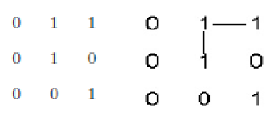
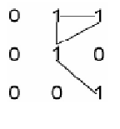
Connectivity
4-adjacency: v = {1} Two pixels p and q with values from V are 4-adjacent if q is in the set N4(p).
8-adjacency: v = {1} Two pixels p and q with values from V are 8-adjacent if q is in the set N8(p)

Slide 5
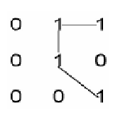
Connectivity
m-adjacency (mixed adjacency): Two pixels p and q with values from V{1} are m-adjacent if: (i) q is in N4(p),or (ii) q is in ND( p) and N4(p) ∩ N4(q) is empty

Slide 6
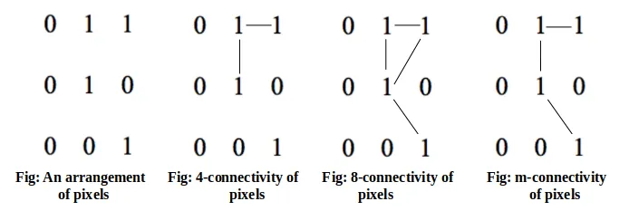
Example

Slide 7
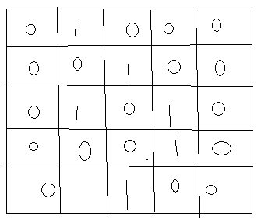
Connectivity?

Slide 8
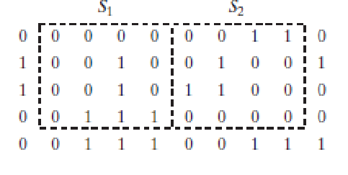
Question
Consider the two image subsets, S1 and S2, shown in the following figure. For V={1}, determine whether these two subsets are (a) 4-adjacent, (b) 8-adjacent, or (c) m-adjacent

Slide 9
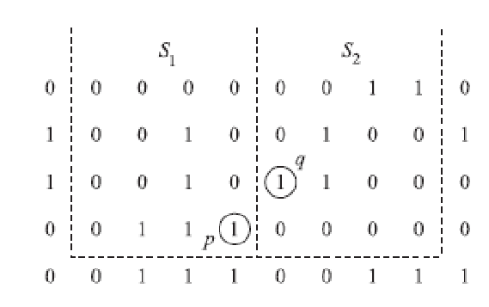
solution
Let p and q be as shown in Fig. Then: (a) S1 and S2 are not 4-connected because q is not in the set N4(p); (b) S1 and S2 are 8-connected because q is in the set N8(p); (c) S1 and S2 are m-connected because (i) q is in ND(p), and (ii) the set N4(p) ∩ N4(q) is empty.

Slide 10
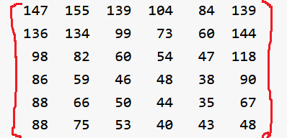
Grayscale image connectivity?
V = {1, 2, 3, ……… 60}

Slide 11
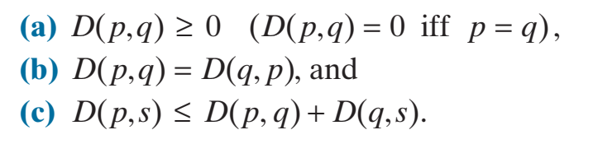
DISTANCE MEASURES
For pixels p, q, and s, with coordinates (x y), (u v), and (w z), respectively, D is a distance function or metric if

Slide 12
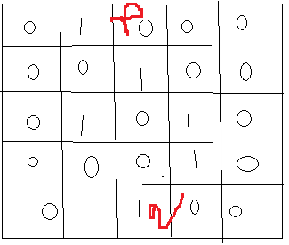
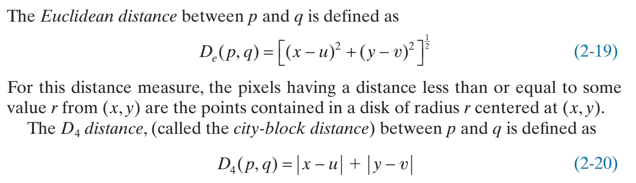
Euclidean and city block distance
F(x, y), F(u, v)
F(1, 3), F(5, 3)
De = [(1-5)^2 + (3 – 3)^2]^1/2
De = (16)^1/2 = 4

Slide 13
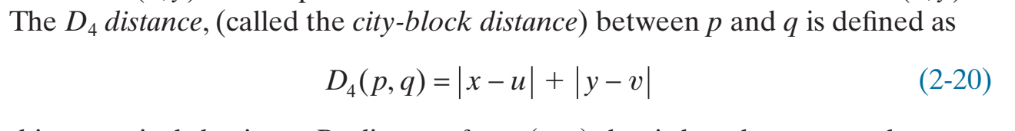
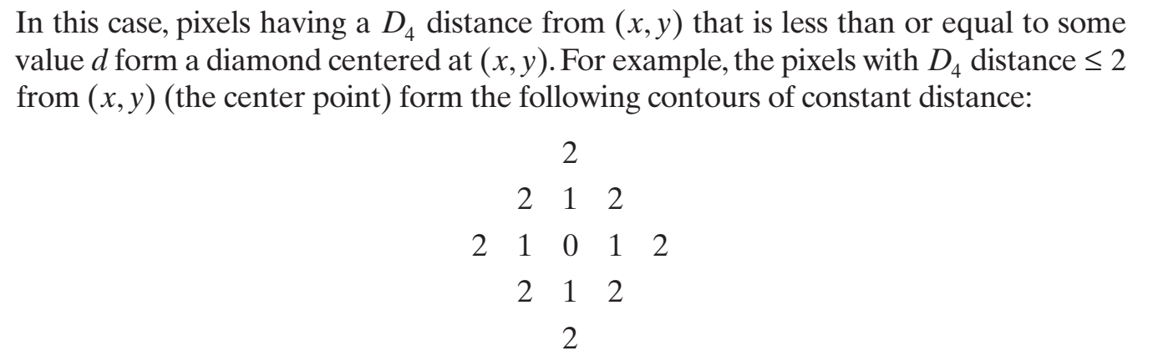
City Block distance

Slide 14
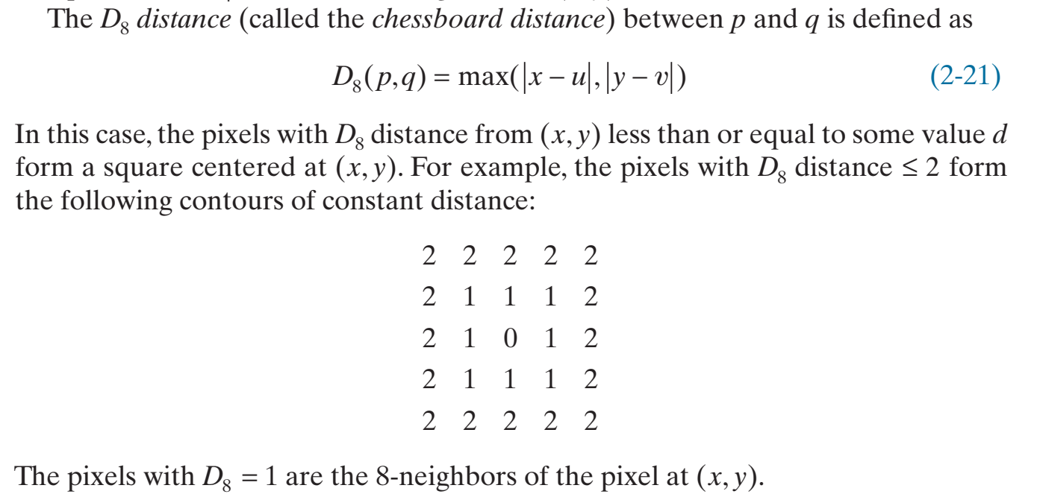
Chessboard distance

Slide 15
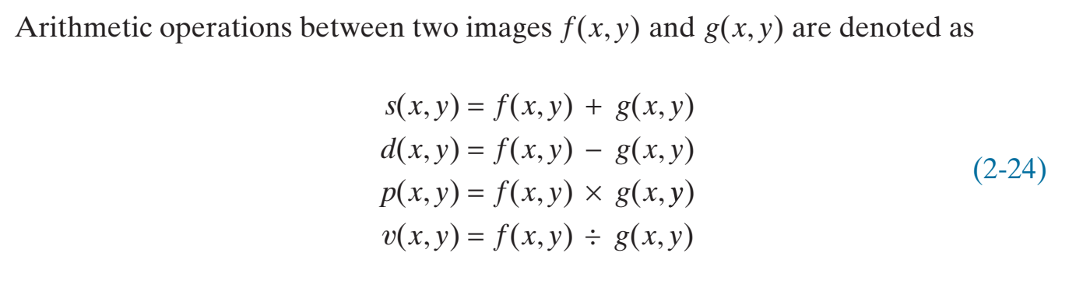
ARITHMETIC OPERATIONS

Slide 16
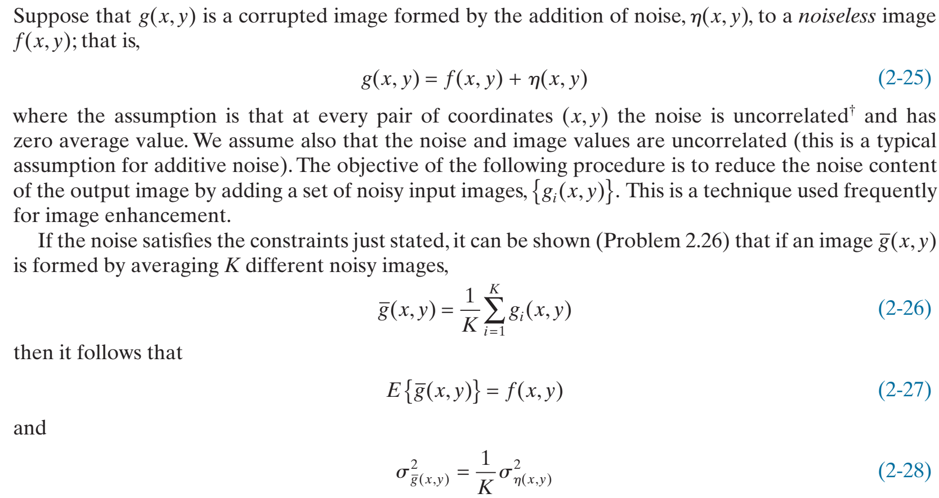
EXAMPLE 2.5 : Using image addition (averaging) for noise reduction.

Slide 17
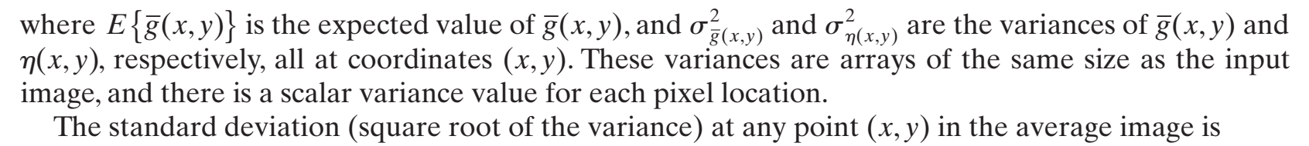
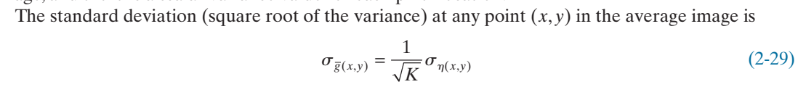
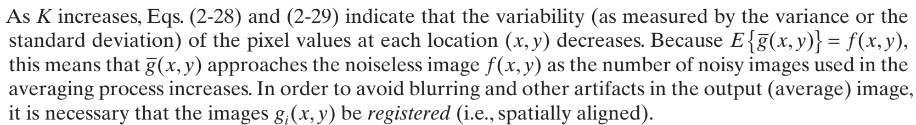
EXAMPLE 2.5 : Using image addition (averaging) for noise reduction.

Slide 18
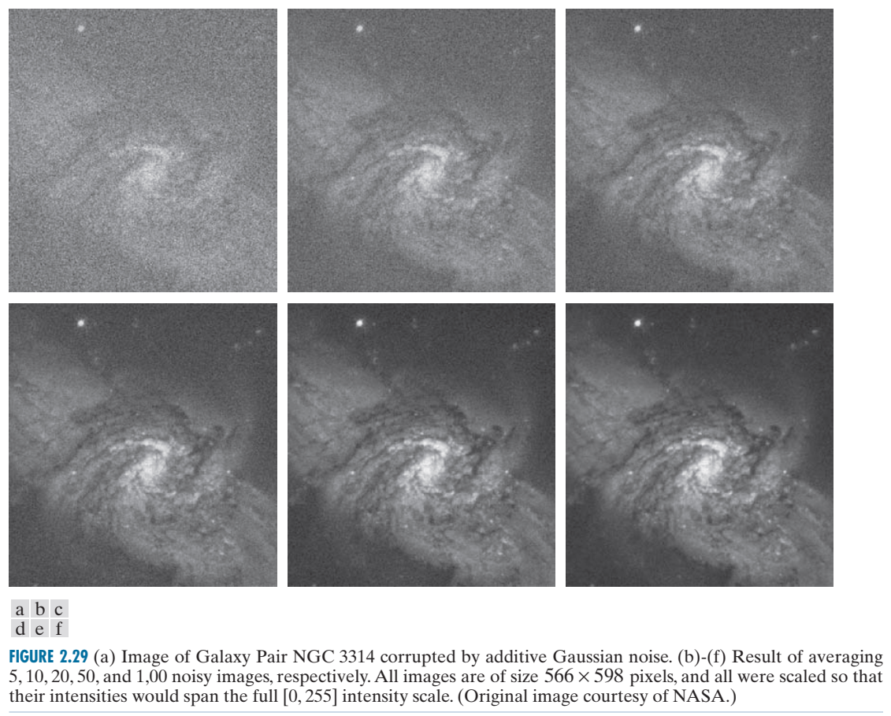

Slide 19
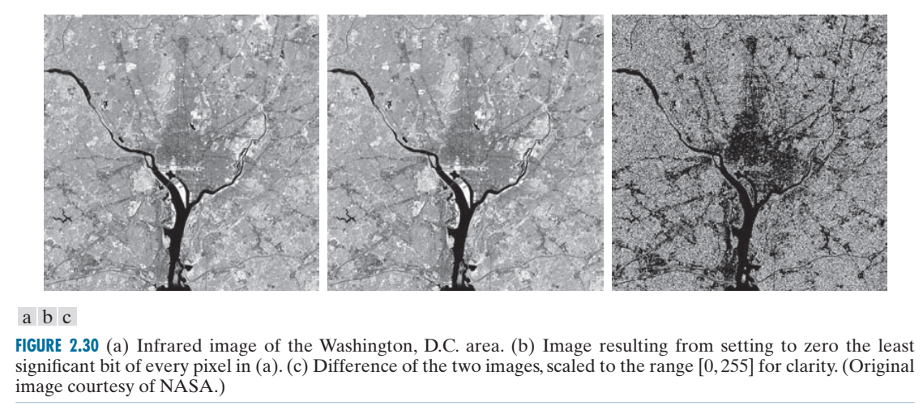

Slide 20
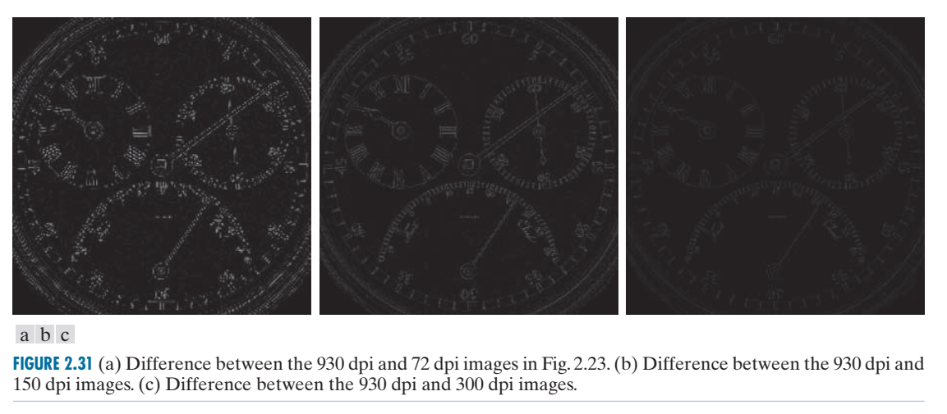
Using image addition (averaging) for noise reduction

Slide 21
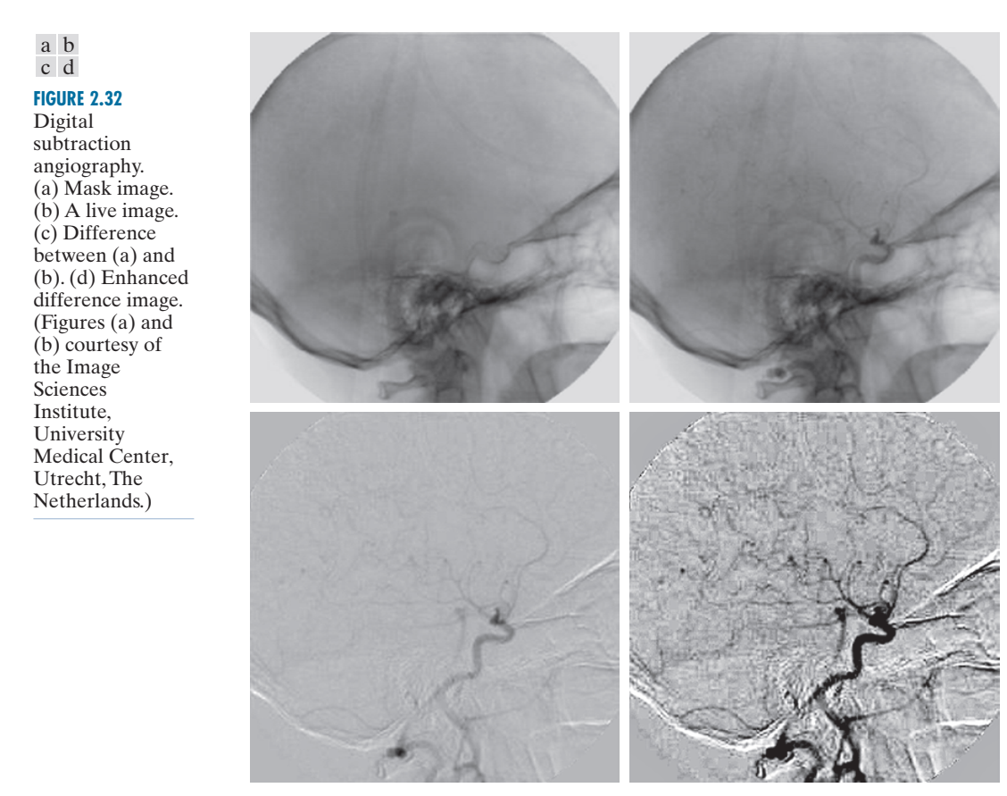

Slide 22
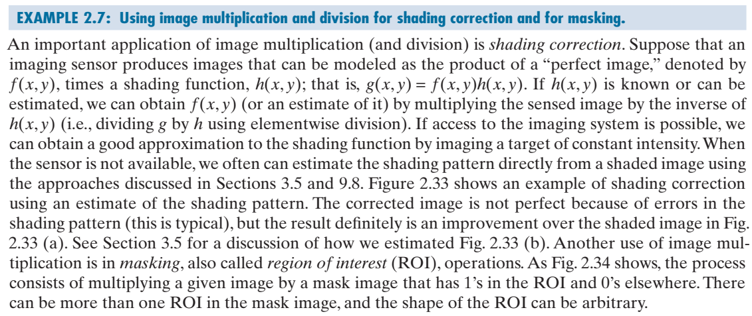
Using image multiplication and division for shading correction and for masking

Slide 23
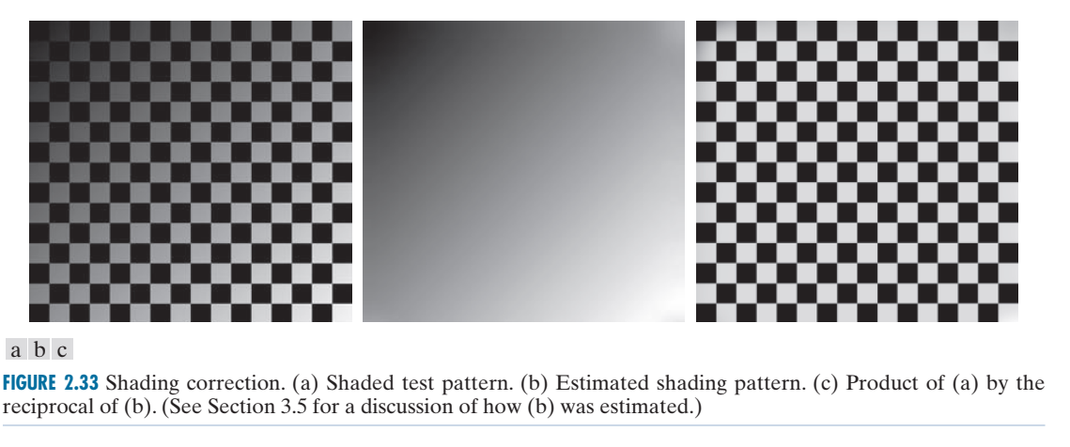
Shading Correction

Slide 24
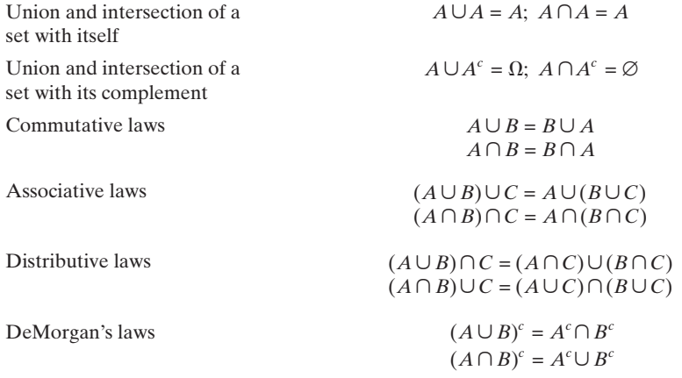

SET AND LOGICAL OPERATIONS

Slide 25
De Morgan Law
A universal set U which consists of all the natural numbers which are multiples of 3, less than or equal to 20. Let A be a subset of U which consists of all the even numbers and the set B is also a subset of U consisting of all the prime numbers. Verify De Morgan Law.
Solution: We have to verify (A ∪ B)’ = A’ ∩ B’ and (A ∩ B)’ = A’∪B’. Given that,
U = {3 , 6 , 9 , 12 , 15 , 18}
A = {6 , 12 , 18}
B = {3}
The union of both A and B can be given as,
A ∪ B = {3 , 6 , 12 , 18}
The complement of this union is given by,
(A ∪ B)’={9 , 15}
Also, the intersection and its complement are given by:
A ∩ B = ∅
(A ∩ B)’ = {3 , 6 , 9 , 12 , 15 ,18}
Now, the complement of the sets A and B can be given as:
A’ = {3 , 9 , 15}
B’ = {6 , 9 , 12 , 15 , 18}
Taking the union of both these sets, we get,
A’∪B’ = {3 , 6 , 9 , 12 , 15 ,18}
And the intersection of the complemented sets is given as,
A’ ∩ B’ = {9 , 15}
We can see that:
(A ∪ B)’ = A’ ∩ B’ = {9 , 15}
And also,
(A ∩ B)’ = A’ ∪ B’ = {3 , 6 , 9 , 12 , 15 ,18}
Hence, the above result is true in general and is known as De Morgan Law.

Slide 26
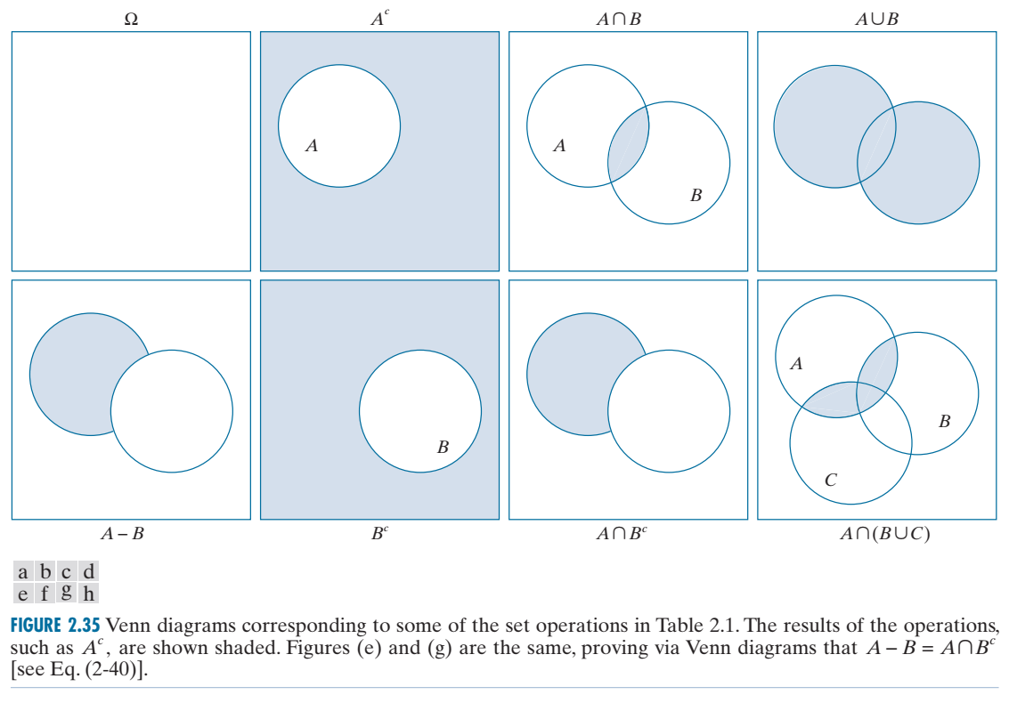
SET AND LOGICAL OPERATIONS

Slide 27
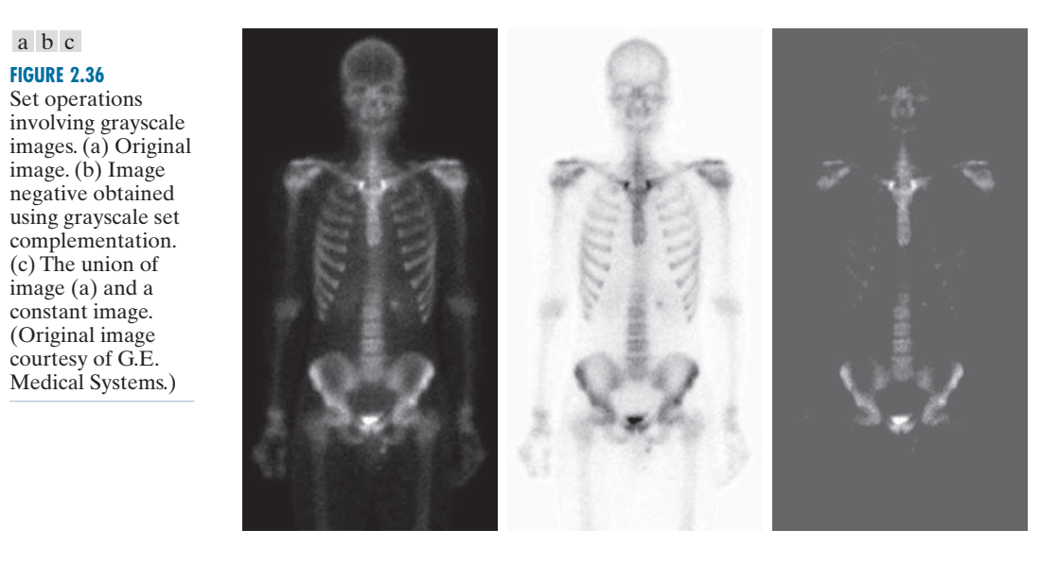

Slide 28
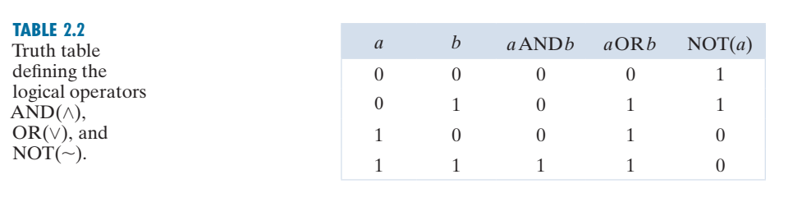
SET AND LOGICAL OPERATIONS

Slide 29
